Slide 2
Niem OVERVIEW
NIEM connects communities of people who share a common need to exchange information in order to advance their missions. NIEM provides a foundation for information exchange between federal, state, local, and tribal agencies. Much more than a data model, NIEM offers an active user community as well as a technical and support framework.
Community
Technical Framework
Support Framework
Formal Governance Processes
Data Model
Tools for Development and Discovery
Online Repositories
XML Design Rules
Established Training Program
Mission-Oriented Domains
Development Methodology
Implementation Support
Self-Managing Domain Stewards
Predefined Deliverables (IEPD)
Help Desk & Knowledge Center

Slide 3
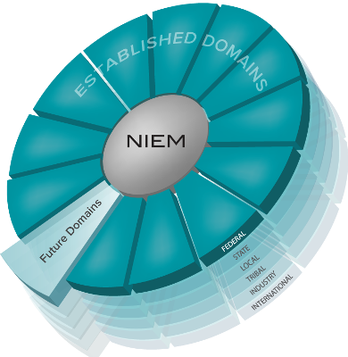
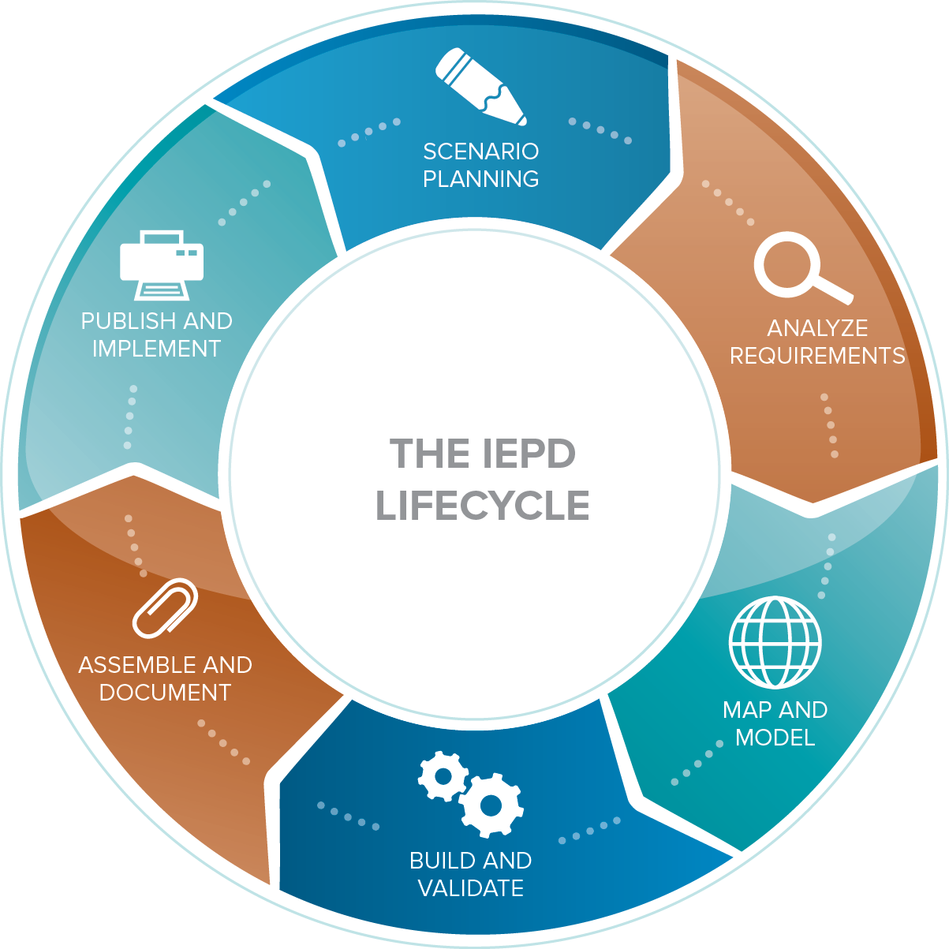
How niem works
How niem works
Common Language (Community-driven Data Model)
Repeatable, Reusable Process
(Information Exchange Development Lifecycle)
Built and governed by the business users at federal, state, local, tribal, international, and private sectors

Slide 4
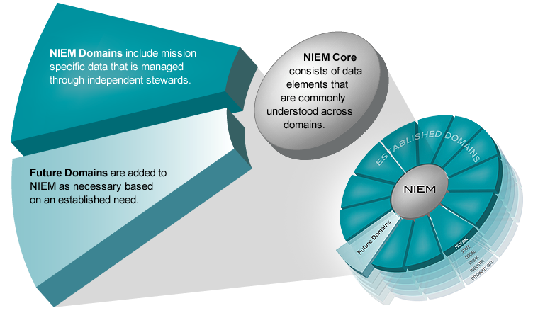
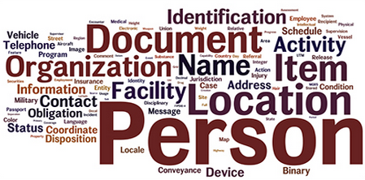
model overview
Think of the NIEM data model as a mature and stable data dictionary of agreed-upon terms, definitions, and formats independent of how information is stored in individual agency systems.
The data model consists of two sets of closely related vocabularies: NIEM Core and individual NIEM Domains.
Biometrics
Chemical, Biological, Radiological, & Nuclear
Cyber (emerging)
Children, Youth, and Family Services
Emergency Management
Health (emerging)
Human Services (emerging)
Immigration
Infrastructure Protection
Intelligence
International Trade
Justice
Maritime
Military Operations
Screening
4

Slide 5
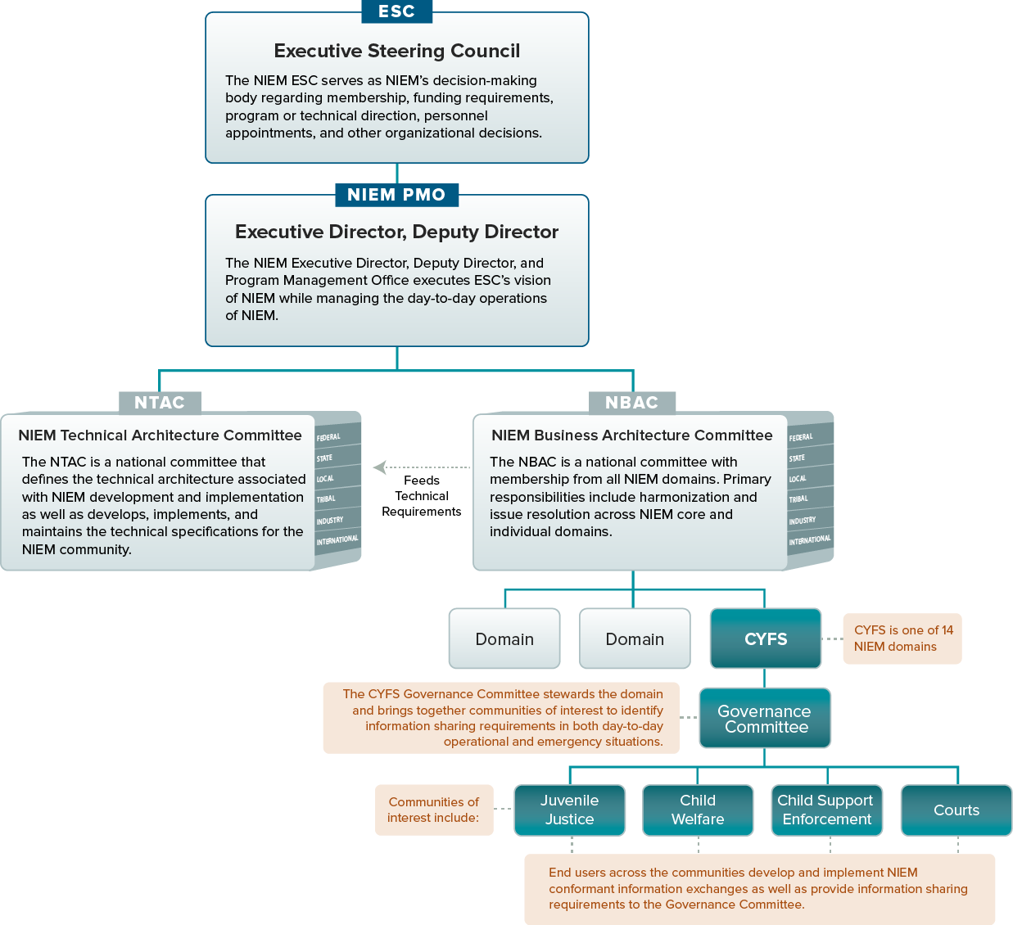
NIEM Governing Structure
Example of a NIEM domain’s cross-jurisdictional governance structure:
NIEM Children, Youth, and Family Services (CYFS) domain supports timely, complete, accurate, and efficient information sharing to improve outcomes for children and youth whose circumstances make them particularly vulnerable.
5

Slide 6
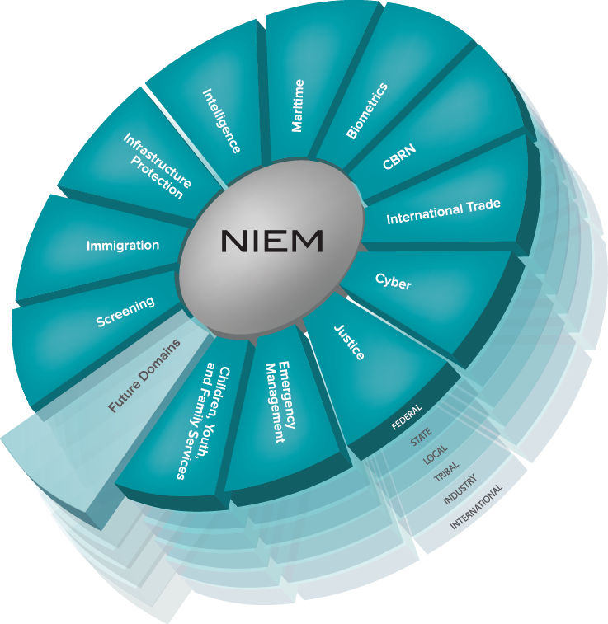



Financial Touch-points
Government Financials
American Recovery and Reinvestment Act of 2009 (ARRA) - Recovery.gov
Contracts/Grants/Cooperative Agreements
Research & Development
Management
Investment Management (CPIC) & IT Dashboard
OMB Exhibit 53
OMB Exhibit 300
TechStat
Travel Management
Real/Personal Property Management
Fleet/Asset Management
Treasury
Financial Crimes Enforcement
Foreign Assets Control

Slide 7
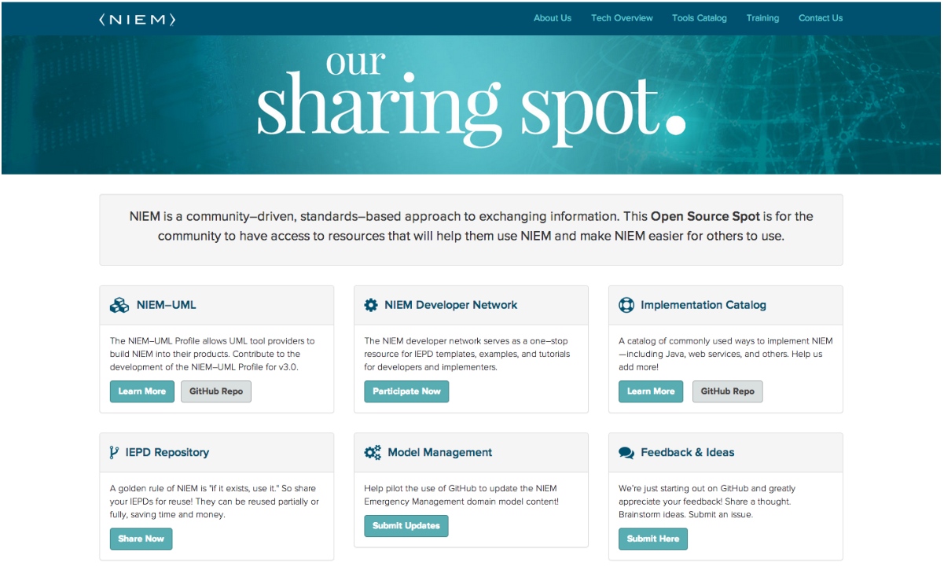
Launching Soon!

Slide 8
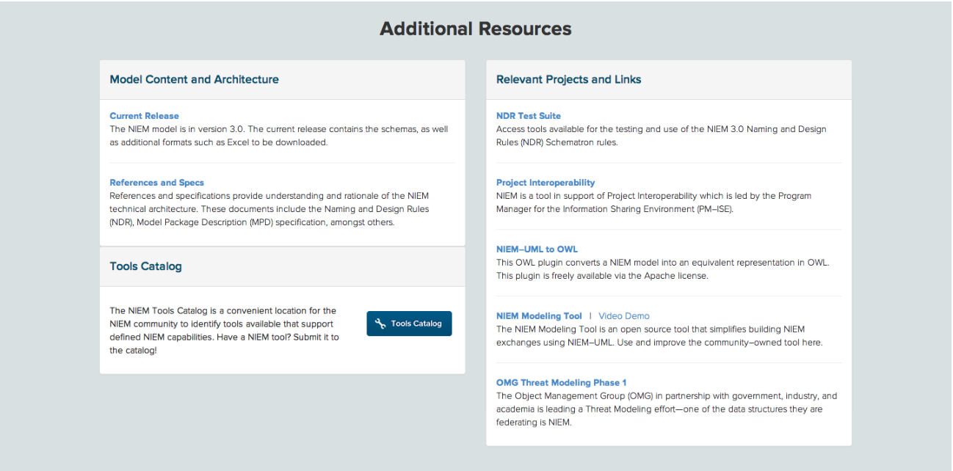
Launching Soon!
Stay tuned to NIEM.gov for information on how YOU can contribute!

